Slide 1

A Silent Tsunami…

Slide 2
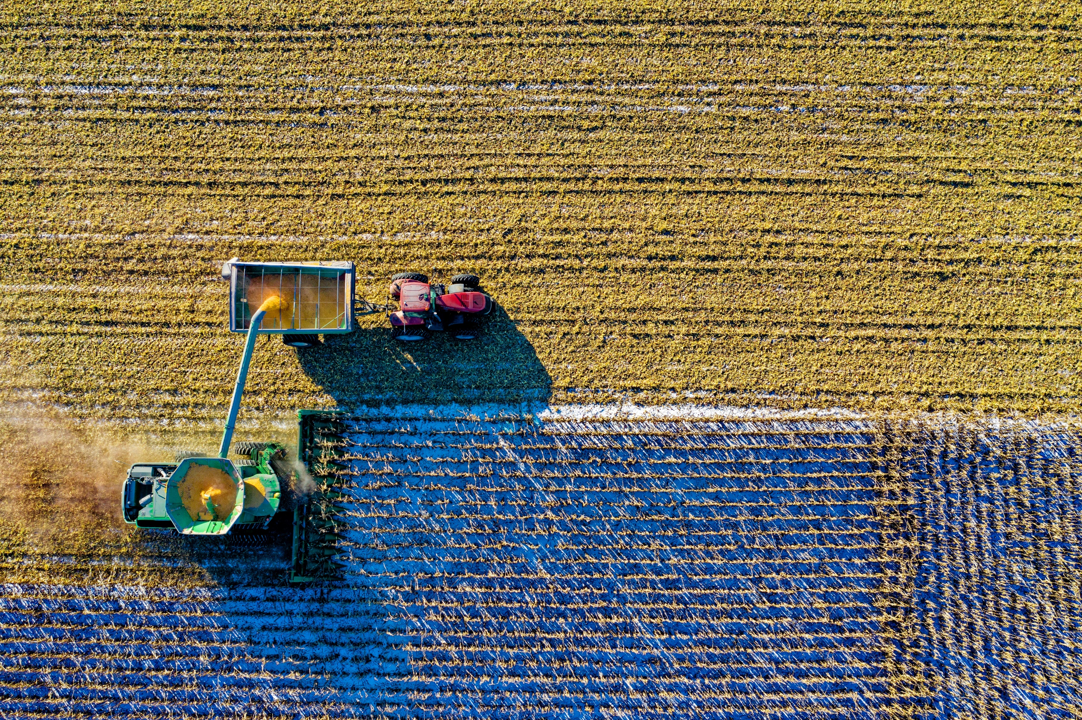
…Food Security

Slide 3

Hunger Facts
Hunger and poverty claim 25 000 lives every day.
854 million people do not have enough to eat – more than the populations of USA, Canada and the European Union.
820 million people in developing countries alone are hungry – one in four lives in sub-Saharan Africa.
524 million of the world’s hungry live in South Asia – more than the populations of Australia and USA.

Slide 4
Hunger Facts
More than 60 per cent of chronically hungry people are women.
Every five seconds a child dies because she or he is hungry.
Undernutrition affects an 350 to 400 million children under the age 18 years.
10.9 million children under five die in developing countries each year. Malnutrition and hunger-related diseases cause 60 per cent of the deaths.
One out of four children – roughly 146 million – in developing countries are underweight.

Slide 5
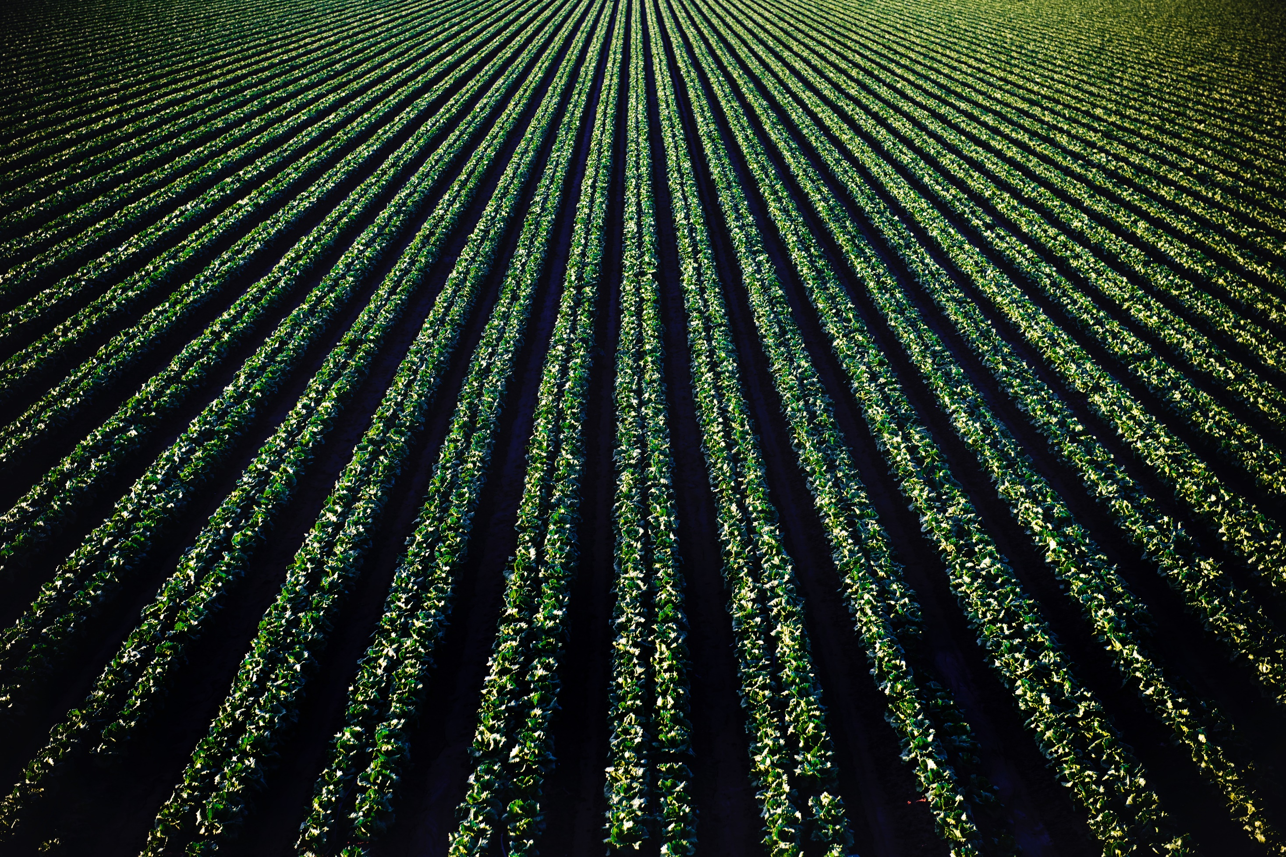
What causes food insecurity?
Think. Pair. Share

Slide 6
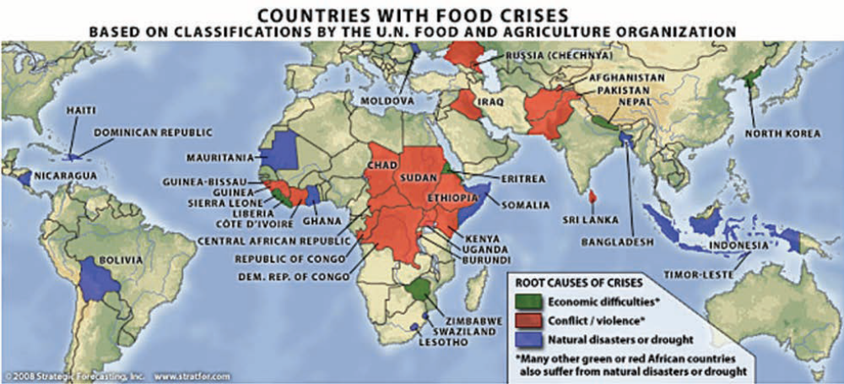

Slide 7
https://www.youtube.com/watch?v=r52h4ljcDvQ
As you watch the clip… take note of the main causes of the food crisis.

Slide 8
Questions
What has this video made you think about?
Summarise each of the causes of the global food crisis?
Climate change - decreases the supply of food available and increases the price (natural disasters)
Fuel – biofuel reduces the supply of food
People – population growth, increases the demand. Rising middle class – demanding more luxury foods such as meat
Production – poor agricultural techniques
Greed – wealthy corporations focussed on making money

Slide 9
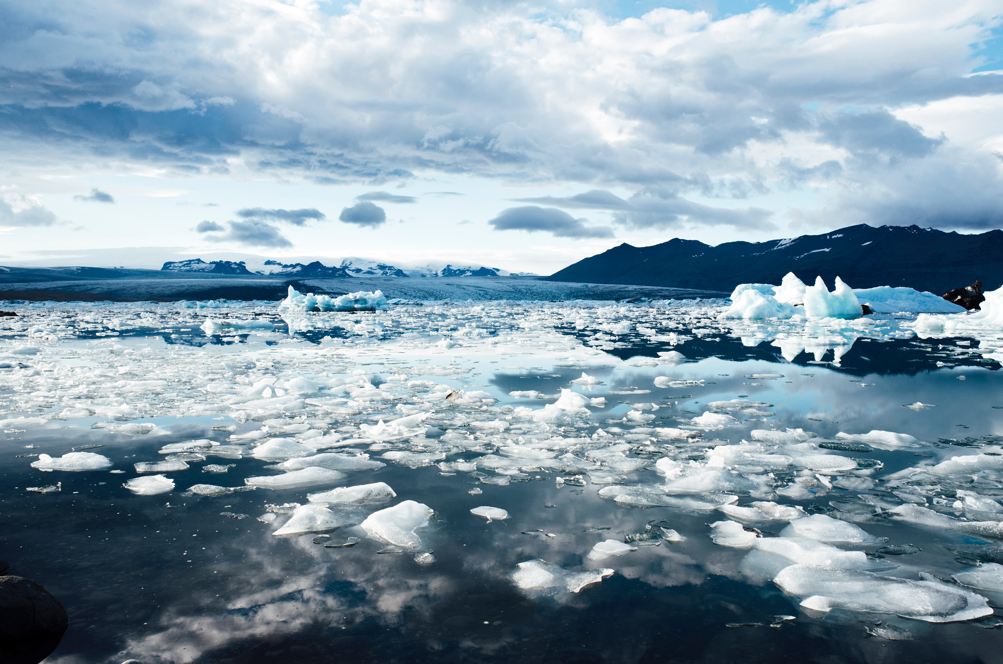
The FAO predicted the food security situation was vulnerable because of:
changing climate

Slide 10

The FAO predicted the food security situation was vulnerable because of:
changing climate
growing demand for meat and other livestock products contributing to the rising price of food grains – the impact of a dietary shift which is directly related to a rise in per capita income in developing countries, especially India and China

Slide 11

The FAO predicted the food security situation was vulnerable because of:
changing climate
growing demand for meat and other livestock products contributing to the rising price of food grains – the impact of a dietary shift which is directly related to a rise in per capita income in developing countries, especially India and China
rising global cereal prices – which are likely to remain high, mainly because of drought-like conditions in major cereal exporting countries (e.g. Australia) and low world stocks (e.g. the price of wheat rose approximately 160 per cent between 2005 and 2007)

Slide 12
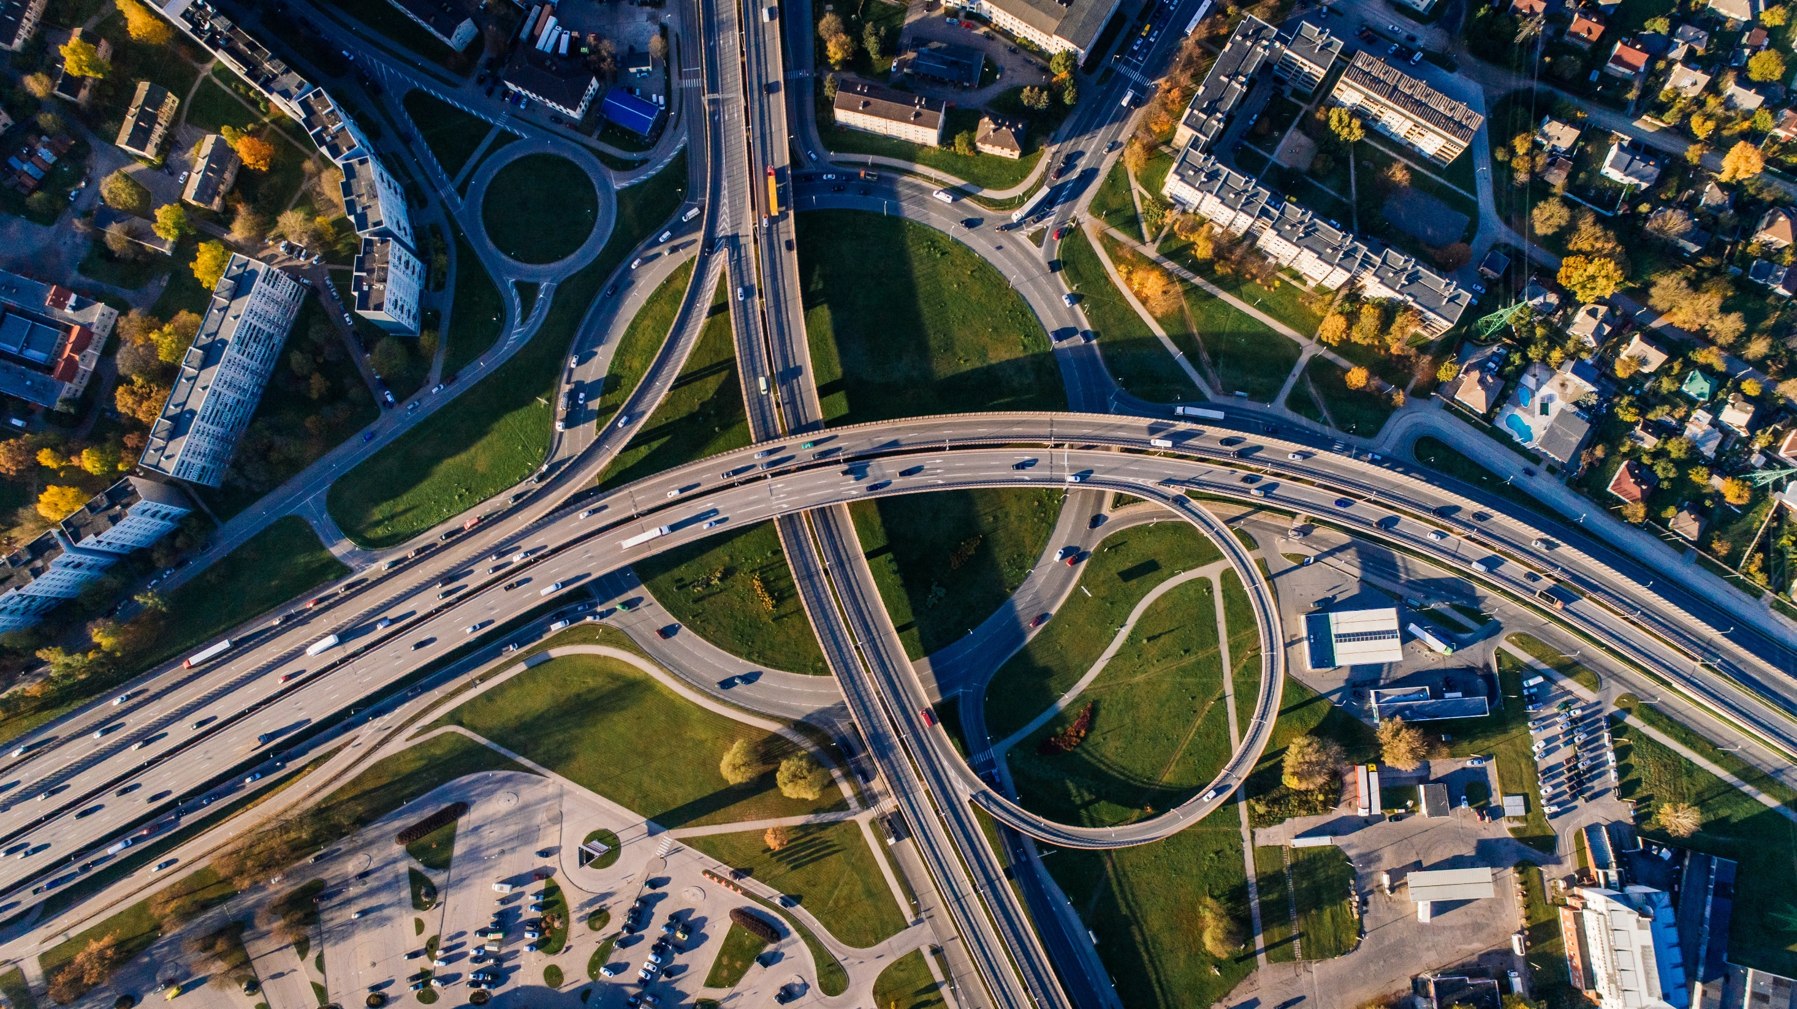
The FAO predicted the food security situation was vulnerable because of:
rising transport rates – the impact of rising fuel prices

Slide 13
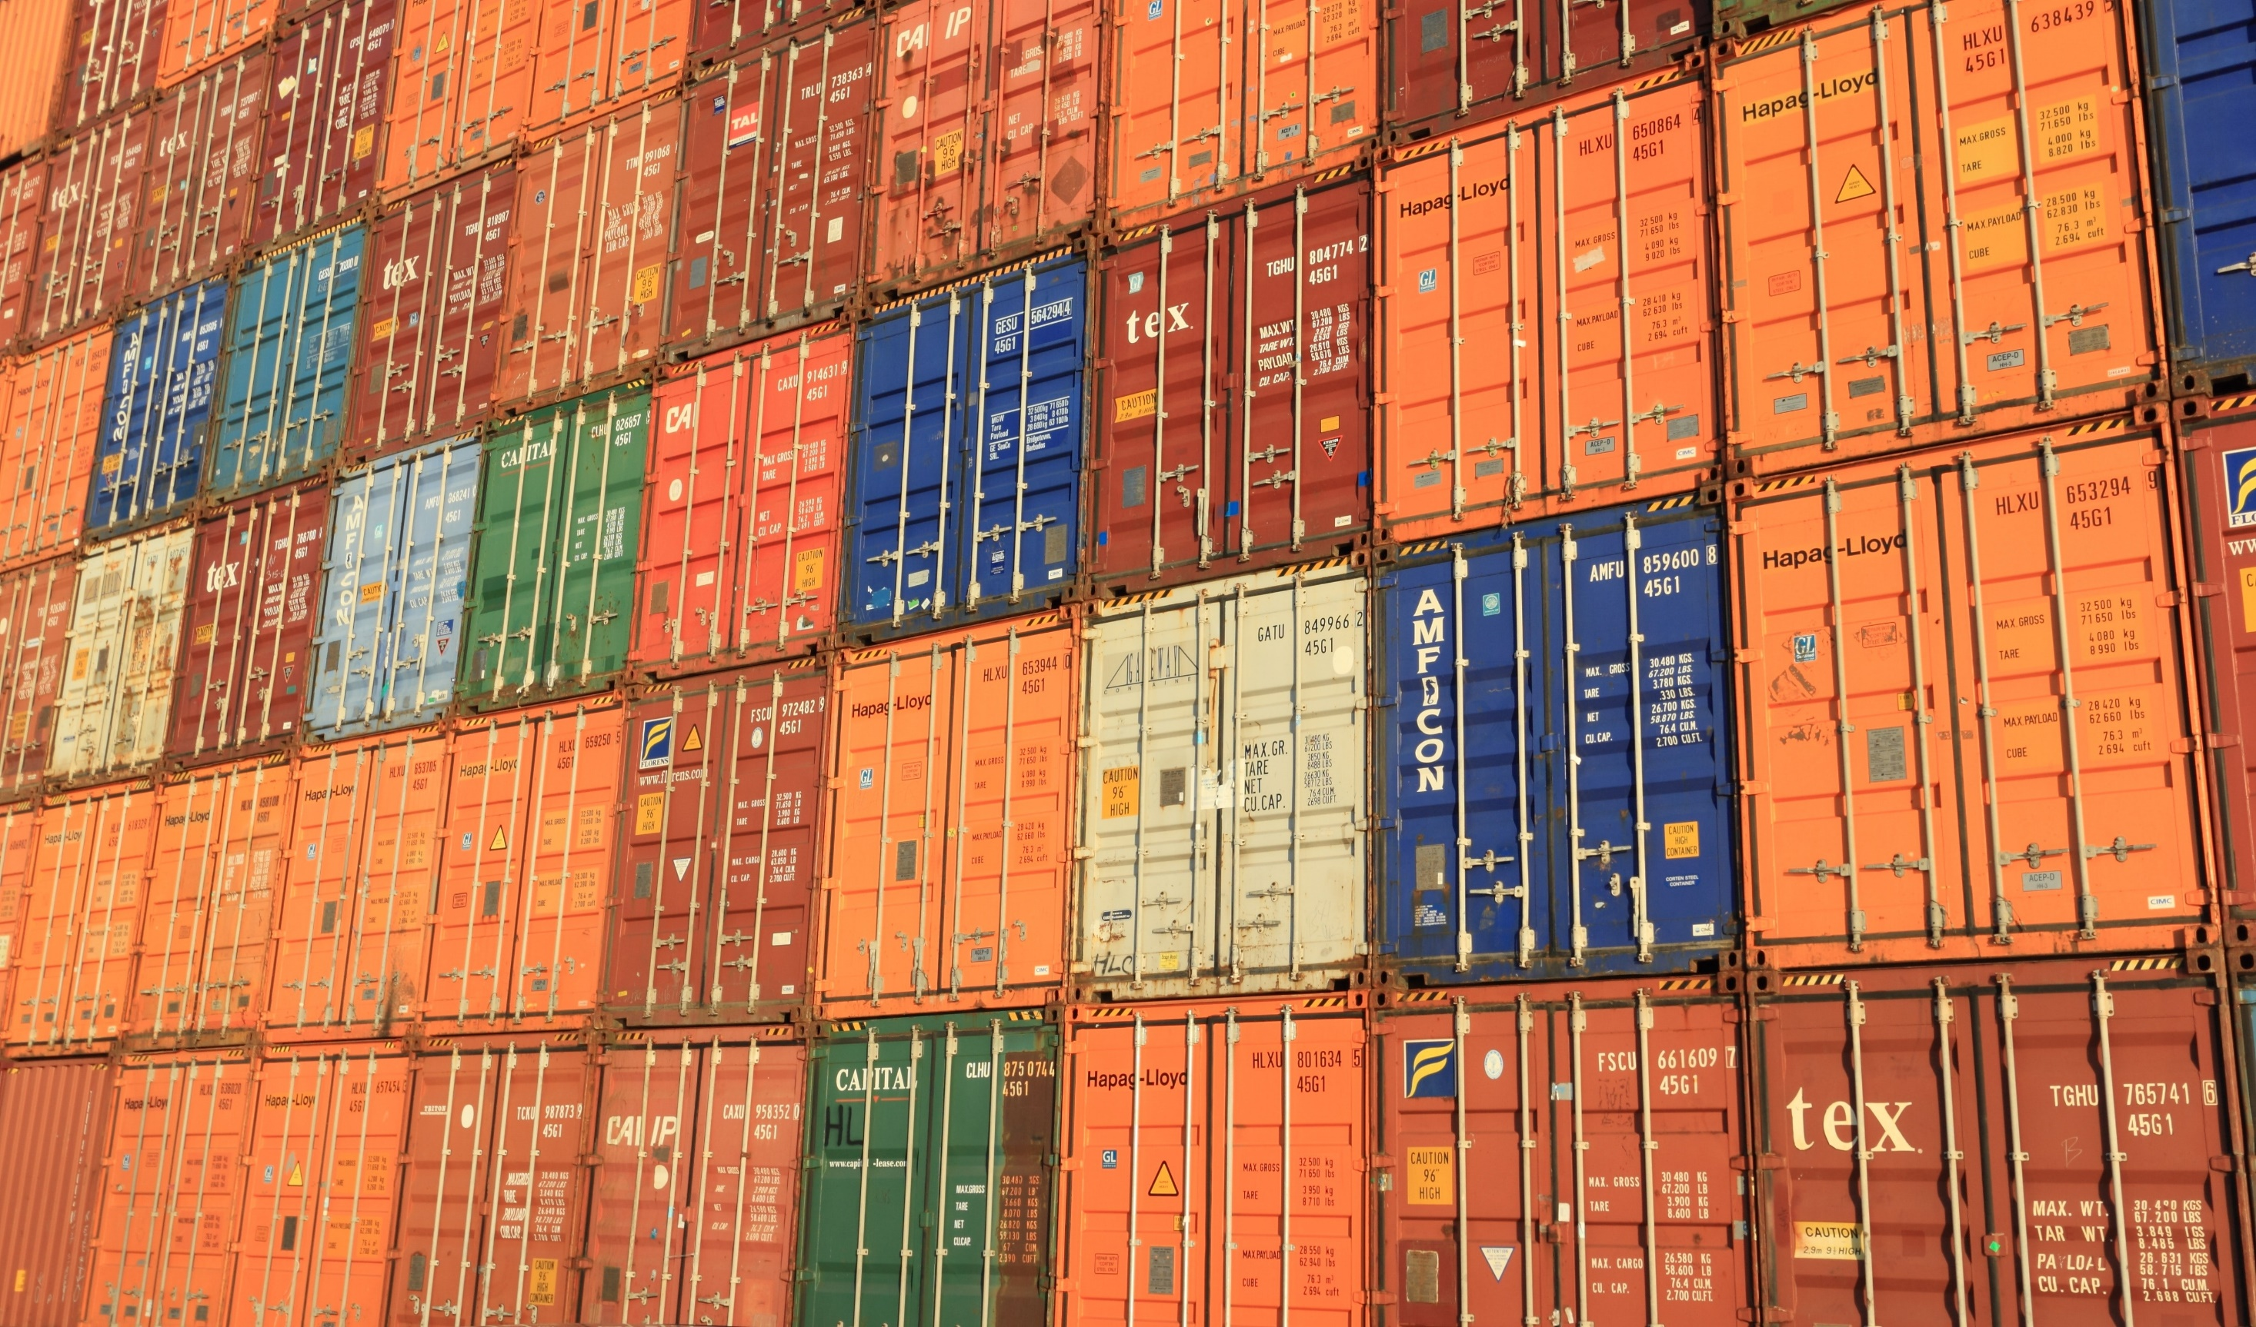
The FAO predicted the food security situation was vulnerable because of:
rising transport rates – the impact of rising fuel prices
rising export prices – many countries will have to pay more than in earlier years for imported cereals from world markets, even though they are expected to import less

Slide 14

The FAO predicted the food security situation was vulnerable because of:
rising transport rates – the impact of rising fuel prices
rising export prices – many countries will have to pay more than in earlier years for imported cereals from world markets, even though they are expected to import less
rising price of fertiliser – the impact of rising fuel prices which increases production costs

Slide 15
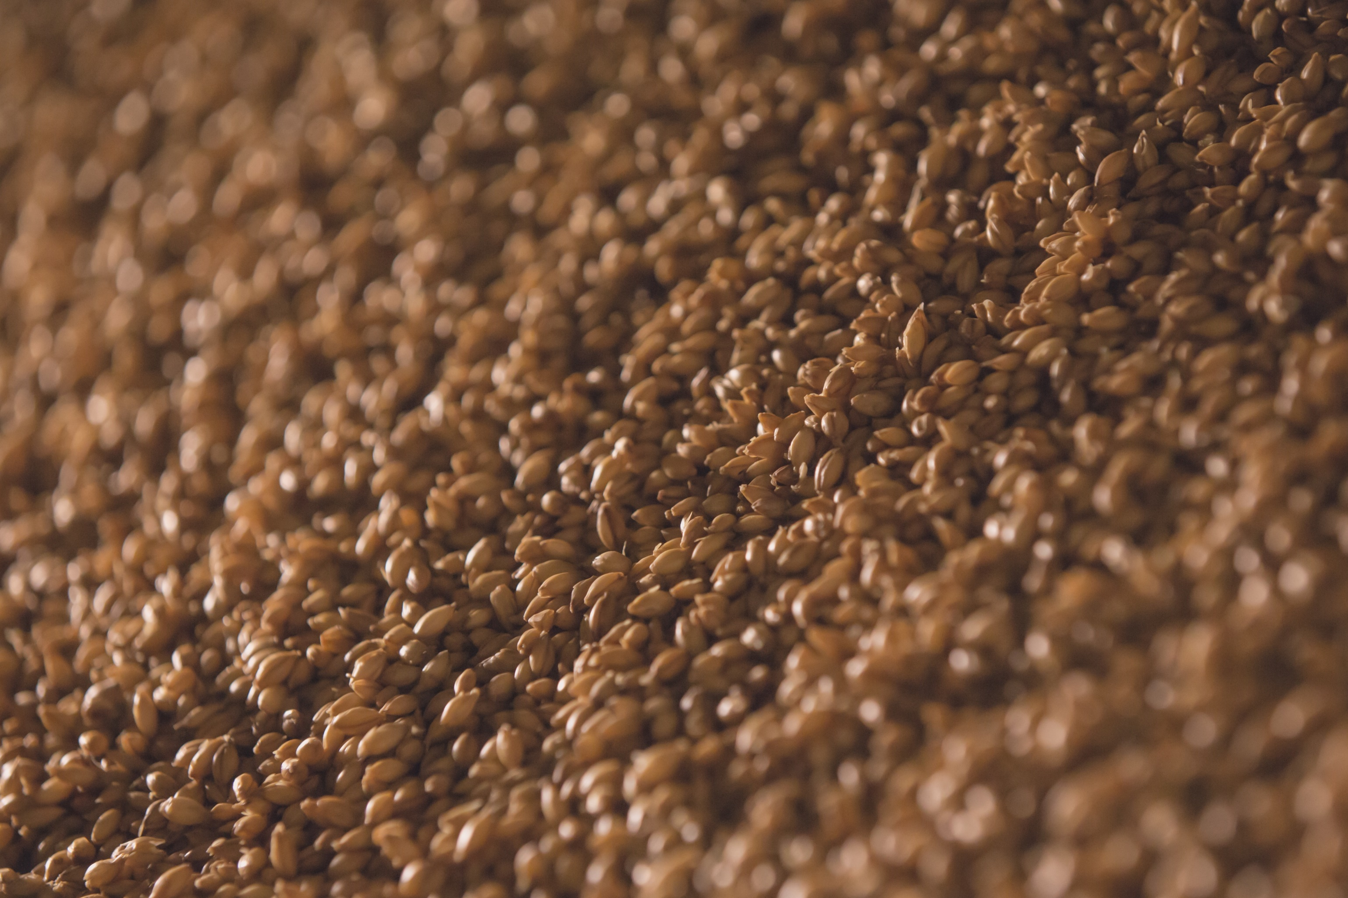
The FAO predicted the food security situation was vulnerable because of:
rising transport rates – the impact of rising fuel prices
rising export prices – many countries will have to pay more than in earlier years for imported cereals from world markets, even though they are expected to import less
rising price of fertiliser – the impact of rising fuel prices which increases production costs
rising price of seed – impacts on production costs

Slide 16

The FAO predicted the food security situation was vulnerable because of:
rising transport rates – the impact of rising fuel prices
rising export prices – many countries will have to pay more than in earlier years for imported cereals from world markets, even though they are expected to import less
rising price of fertiliser – the impact of rising fuel prices which increases production costs
rising price of seed – impacts on production costs
shifting preferences in cropping patterns – the swing away from growing food crops to biofuels.

Slide 17
Read Pages 48 – 53 of People, Places and Perspectives 9
Then have a go completing activities:
1
3
4
EXTENSION
5

Slide 18
References
Aus Aid. (2008). A ‘silent tsnunami’:Global Food Security in the 21st Century. (PDF).
WorldvisionStir. (21 April 2009). The Silent Tsunami. [youtube]. Accessed from https://www.youtube.com/watch?v=r52h4ljcDvQ

